Slide 1
Introduction to Differential Equations - Lecture 6
Fei Qi
Email: fei.qi@du.edu
Office Hour: TBA
Website: https://feiqimath.github.io

Slide 2
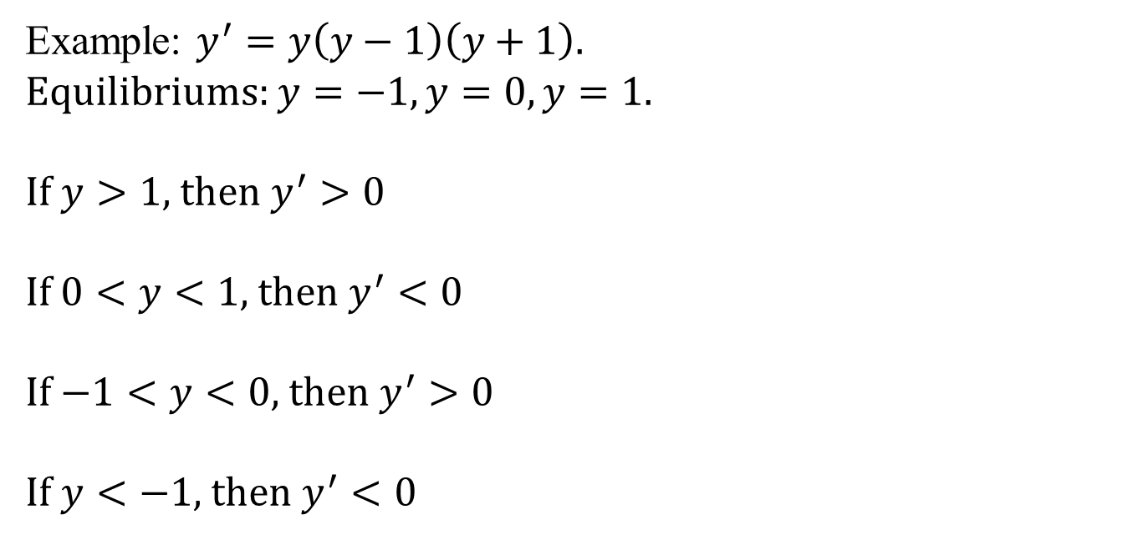



More examples
Example: $y^{′}=y\left(y−1\right)\left(y+1\right)$.
Equilibriums: $y=−1,y=0,y=1.$
If $y>1$, then $y^{′}>0$
If $0<y<1,$ then $y^{′}<0$
If $−1<y<0$, then $y^{′}>0$
If $y<−1,$ then $y^{′}<0$
$1$
unstable
$0$
stable
$−1$
unstable

Slide 3
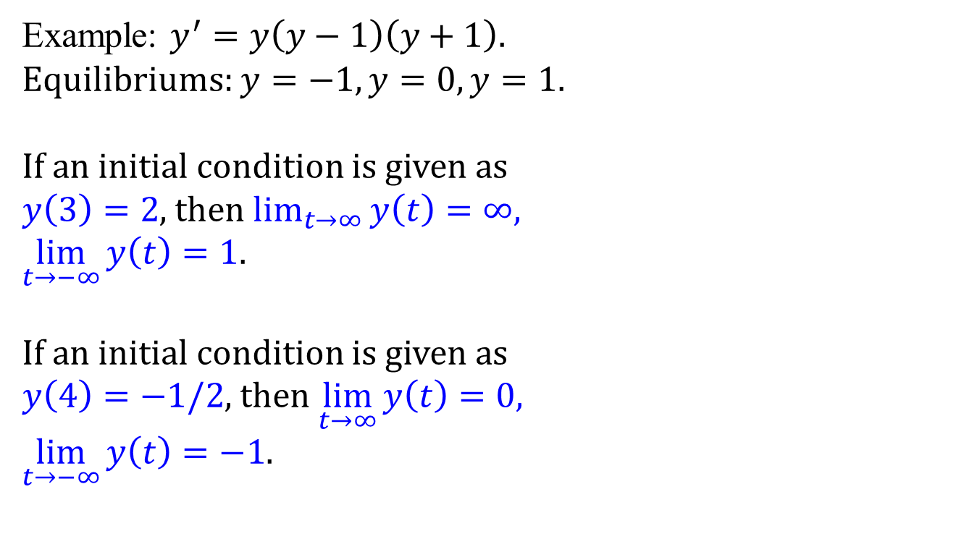
More examples
Example: $y^{′}=y\left(y−1\right)\left(y+1\right)$.
Equilibriums: $y=−1,y=0,y=1.$
If an initial condition is given as $y\left(3\right)=2$, then $\lim_{t→∞}{y\left(t\right)=∞,}$ $\lim_{t→−∞}{y\left(t\right)=1}$.
If an initial condition is given as $y\left(4\right)=−1/2$, then $\lim_{t→∞}{y\left(t\right)=0,}$ $\lim_{t→−∞}{y\left(t\right)=−1}$.
$1$
unstable
$0$
stable
$−1$
unstable

Slide 4

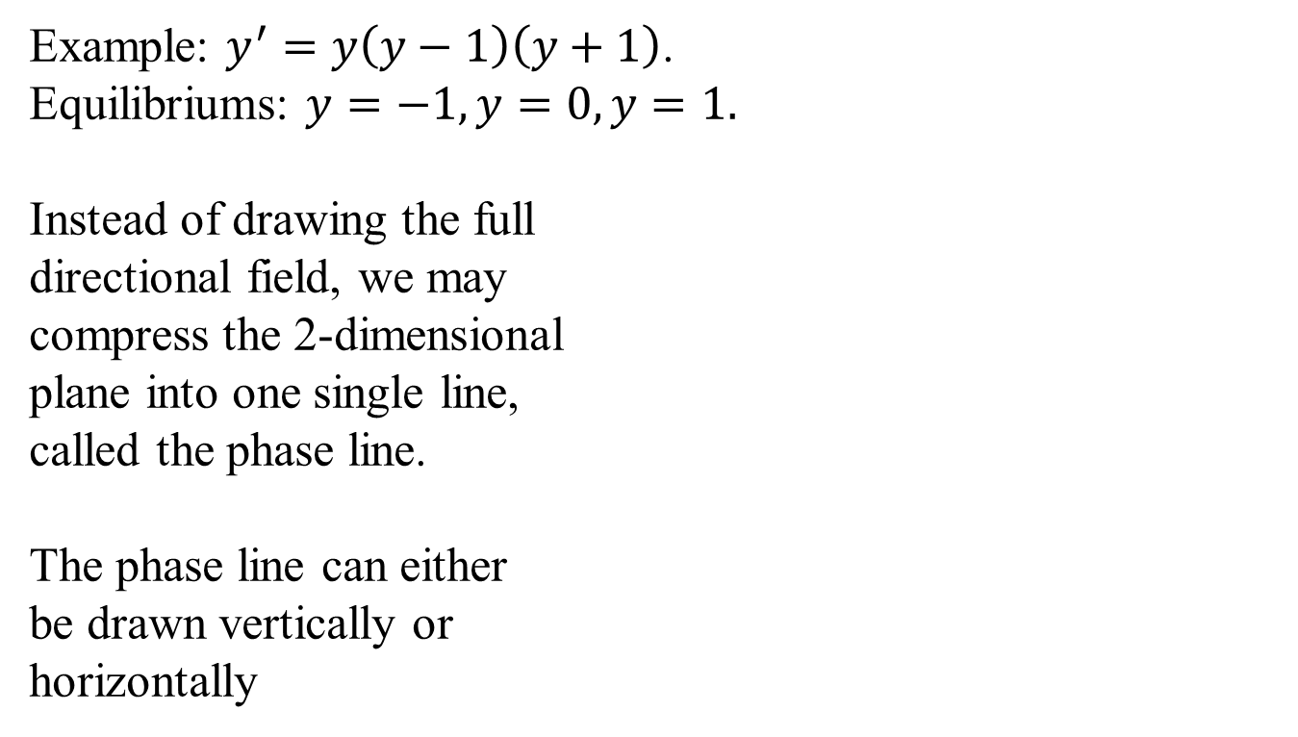





Phase Line
Example: $y^{′}=y\left(y−1\right)\left(y+1\right)$.
Equilibriums: $y=−1,y=0,y=1.$
Instead of drawing the full directional field, we may compress the 2-dimensional plane into one single line, called the phase line.
The phase line can either be drawn vertically or horizontally
$1$
$1$
unstable
$0$
$0$
stable
$−1$
$−1$
unstable
$−1$
$0$
$1$

Slide 5
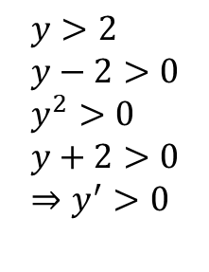
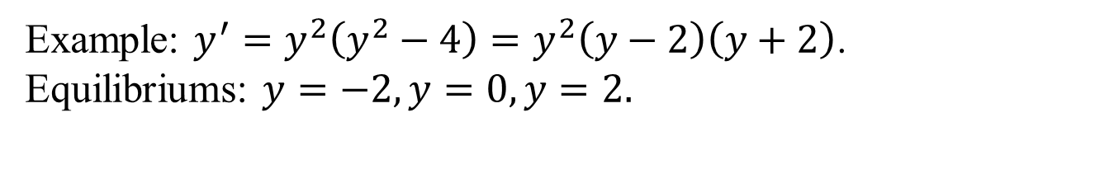
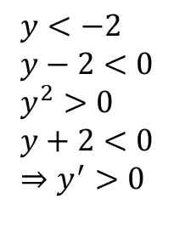
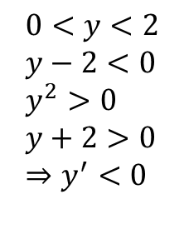
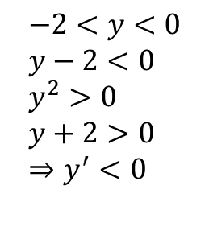



Phase Line
Example: $y^{′}=y^{2}\left(y^{2}−4\right)=y^{2}\left(y−2\right)\left(y+2\right)$.
Equilibriums: $y=−2,y=0,y=2.$
stable
semistable
unstable
$$−2$$
$$0$$
$$2$$
$$y<−2 \\ y−2<0 \\ y^{2}>0 \\ y+2<0 \\ ⇒y^{′}>0$$
$$−2<y<0 \\ y−2<0 \\ y^{2}>0 \\ y+2>0 \\ ⇒y^{′}<0$$
$$0<y<2 \\ y−2<0 \\ y^{2}>0 \\ y+2>0 \\ ⇒y^{′}<0$$
$$y>2 \\ y−2>0 \\ y^{2}>0 \\ y+2>0 \\ ⇒y^{′}>0$$

Slide 6





Phase Line
Example: $y^{′}=f(y)$ where the graph of $f(y)$ is given
stable
$$−1$$
stable
$$−3$$
$$0$$
$$2$$
unstable
unstable

Slide 7
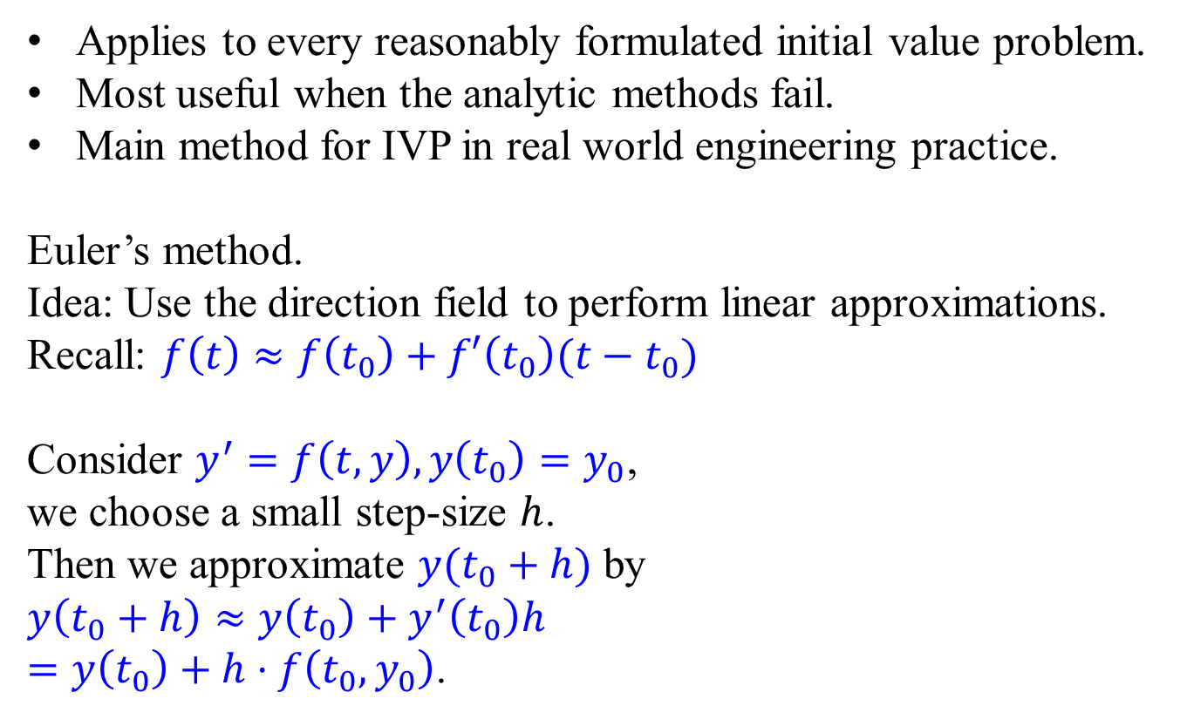




Numerical Methods
Applies to every reasonably formulated initial value problem.
Most useful when the analytic methods fail.
Main method for IVP in real world engineering practice.
Euler’s method. Idea: Use the direction field to perform linear approximations.
Recall: $f\left(t\right)≈f\left(t_{0}\right)+f′\left(t_{0}\right)(t−t_{0})$
Consider $y^{′}=f\left(t,y\right),y\left(t_{0}\right)=y_{0}$,
we choose a small step-size $h$.
Then we approximate $y(t_{0}+h)$ by
$y\left(t_{0}+h\right)≈y\left(t_{0}\right)+y^{′}\left(t_{0}\right)h$ $=y\left(t_{0}\right)+h⋅f\left(t_{0},y_{0}\right)$.
$${y(t}_{0}+h)$$
$${y(t}_{0})$$
$$t_{0}$$
$$t_{0}+h$$

Slide 8

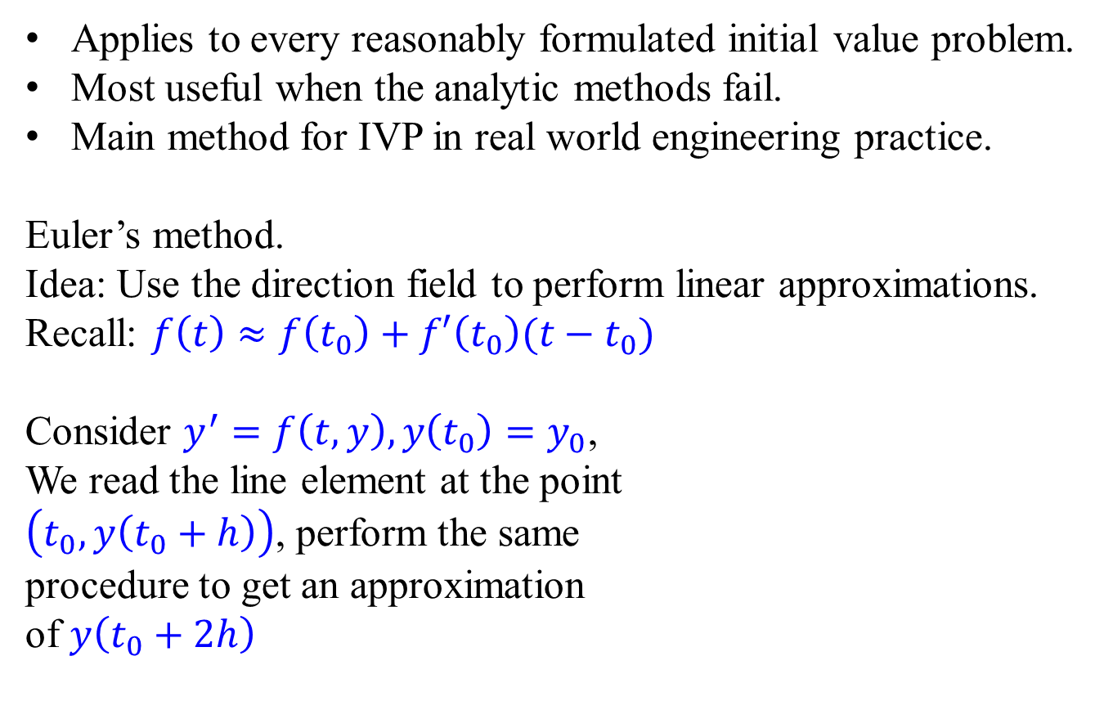

Numerical Methods
Applies to every reasonably formulated initial value problem.
Most useful when the analytic methods fail.
Main method for IVP in real world engineering practice.
Euler’s method. Idea: Use the direction field to perform linear approximations.
Recall: $f\left(t\right)≈f\left(t_{0}\right)+f′\left(t_{0}\right)(t−t_{0})$
Consider $y^{′}=f\left(t,y\right),y\left(t_{0}\right)=y_{0}$,
We read the line element at the point $\left(t_{0},y\left(t_{0}+h\right)\right)$, perform the same procedure to get an approximation of $y\left(t_{0}+2h\right)$
$${y(t}_{0}+2h)$$
$${y(t}_{0}+h)$$
$${y(t}_{0})$$
$$t_{0}$$
$$t_{0}+h$$
$$t_{0}+2h$$

Slide 9
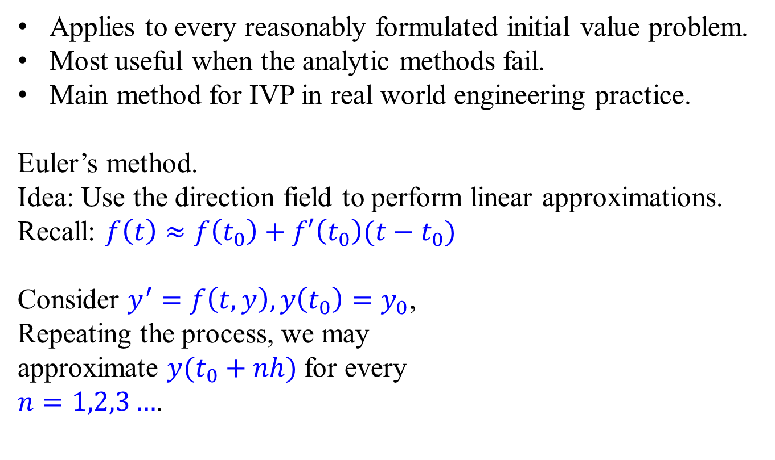
Numerical Methods
Applies to every reasonably formulated initial value problem.
Most useful when the analytic methods fail.
Main method for IVP in real world engineering practice.
Euler’s method. Idea: Use the direction field to perform linear approximations.
Recall: $f\left(t\right)≈f\left(t_{0}\right)+f′\left(t_{0}\right)(t−t_{0})$
Consider $y^{′}=f\left(t,y\right),y\left(t_{0}\right)=y_{0}$,
Repeating the process, we may approximate $y(t_{0}+nh)$ for every $n=1,2,3…$.
$${y(t}_{0}+2h)$$
$${y(t}_{0}+h)$$
$${y(t}_{0})$$
$$t_{0}$$
$$t_{0}+h$$
$$t_{0}+2h$$

Slide 10
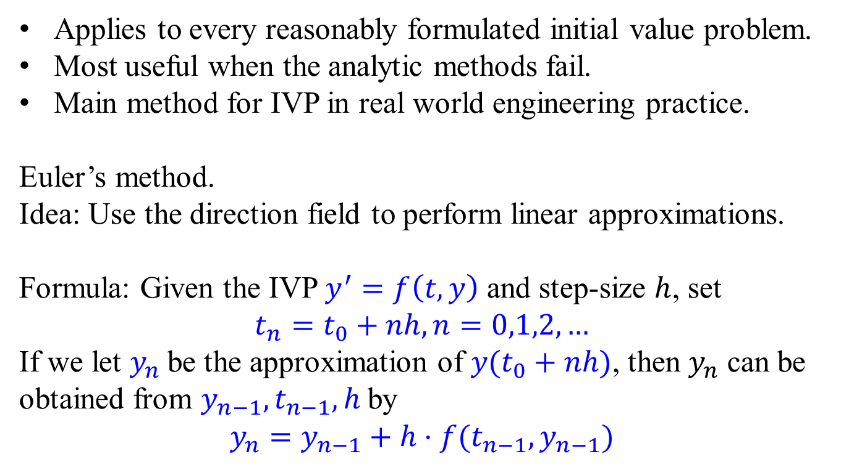
Numerical Methods
Applies to every reasonably formulated initial value problem.
Most useful when the analytic methods fail.
Main method for IVP in real world engineering practice.
Euler’s method. Idea: Use the direction field to perform linear approximations.
Formula: Given the IVP $y^{′}=f\left(t,y\right)$ and step-size $h$, set
$$t_{n}=t_{0}+nh,n=0,1,2,…$$
If we let $y_{n}$ be the approximation of $y(t_{0}+nh)$, then $y_{n}$ can be obtained from $y_{n−1}, t_{n−1}, h$ by
$$y_{n}=y_{n−1}+h⋅f(t_{n−1},y_{n−1})$$

Slide 11
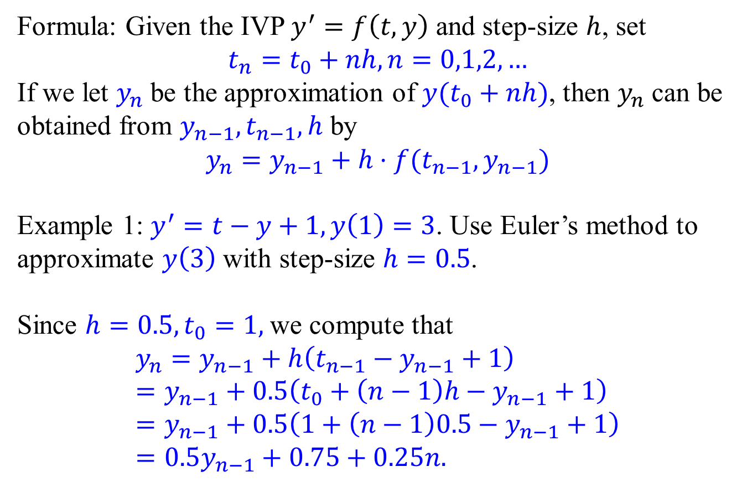
Euler’s method – Example 1
Formula: Given the IVP $y^{′}=f\left(t,y\right)$ and step-size $h$, set
$$t_{n}=t_{0}+nh,n=0,1,2,…$$
If we let $y_{n}$ be the approximation of $y(t_{0}+nh)$, then $y_{n}$ can be obtained from $y_{n−1}, t_{n−1}, h$ by
$$y_{n}=y_{n−1}+h⋅f(t_{n−1},y_{n−1})$$
Example 1: $y^{′}=t−y+1,y\left(1\right)=3$. Use Euler’s method to approximate $y\left(3\right)$ with step-size $h=0.5$.
Since $h=0.5, t_{0}=1,$we compute that $$y_{n}=y_{n−1}+h\left(t_{n−1}−y_{n−1}+1\right)=y_{n−1}+0.5\left(t_{0}+\left(n−1\right)h−y_{n−1}+1\right) \\ =y_{n−1}+0.5\left(1+\left(n−1\right)0.5−y_{n−1}+1\right) \\ =0.5y_{n−1}+0.75+0.25n.$$

Slide 12
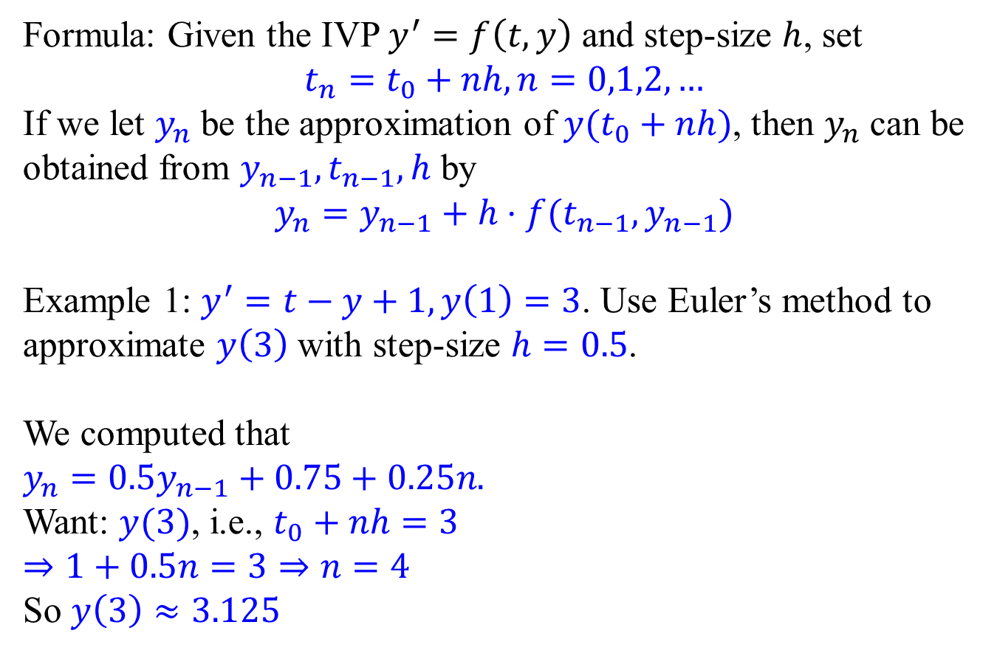
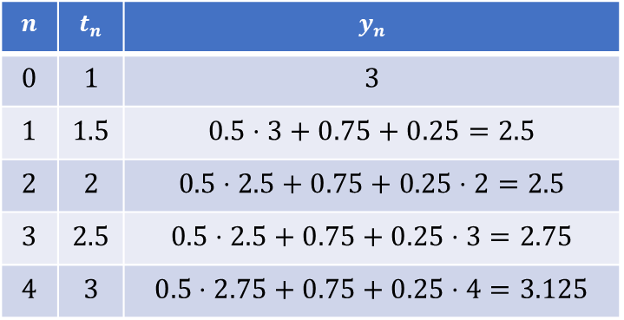
Euler’s method – Example 1
Formula: Given the IVP $y^{′}=f\left(t,y\right)$ and step-size $h$, set
$$t_{n}=t_{0}+nh,n=0,1,2,…$$
If we let $y_{n}$ be the approximation of $y(t_{0}+nh)$, then $y_{n}$ can be obtained from $y_{n−1}, t_{n−1}, h$ by
$$y_{n}=y_{n−1}+h⋅f(t_{n−1},y_{n−1})$$
Example 1: $y^{′}=t−y+1,y\left(1\right)=3$. Use Euler’s method to approximate $y\left(3\right)$ with step-size $h=0.5$.
We computed that $y_{n}=0.5y_{n−1}+0.75+0.25n.$
Want: $y(3)$, i.e., $t_{0}+nh=3$
$⇒1+0.5n=3⇒n=4$
So $y\left(3\right)≈3.125$
$$n$$ | $$t_{n}$$ | $$y_{n}$$
$$0$$ | $$1$$ | $$3$$
$$1$$ | $$1.5$$ | $$0.5⋅3+0.75+0.25=2.5$$
$$2$$ | $$2$$ | $$0.5⋅2.5+0.75+0.25⋅2=2.5$$
$$3$$ | $$2.5$$ | $$0.5⋅2.5+0.75+0.25⋅3=2.75$$
$$4$$ | $$3$$ | $$0.5⋅2.75+0.75+0.25⋅4=3.125$$

Slide 13
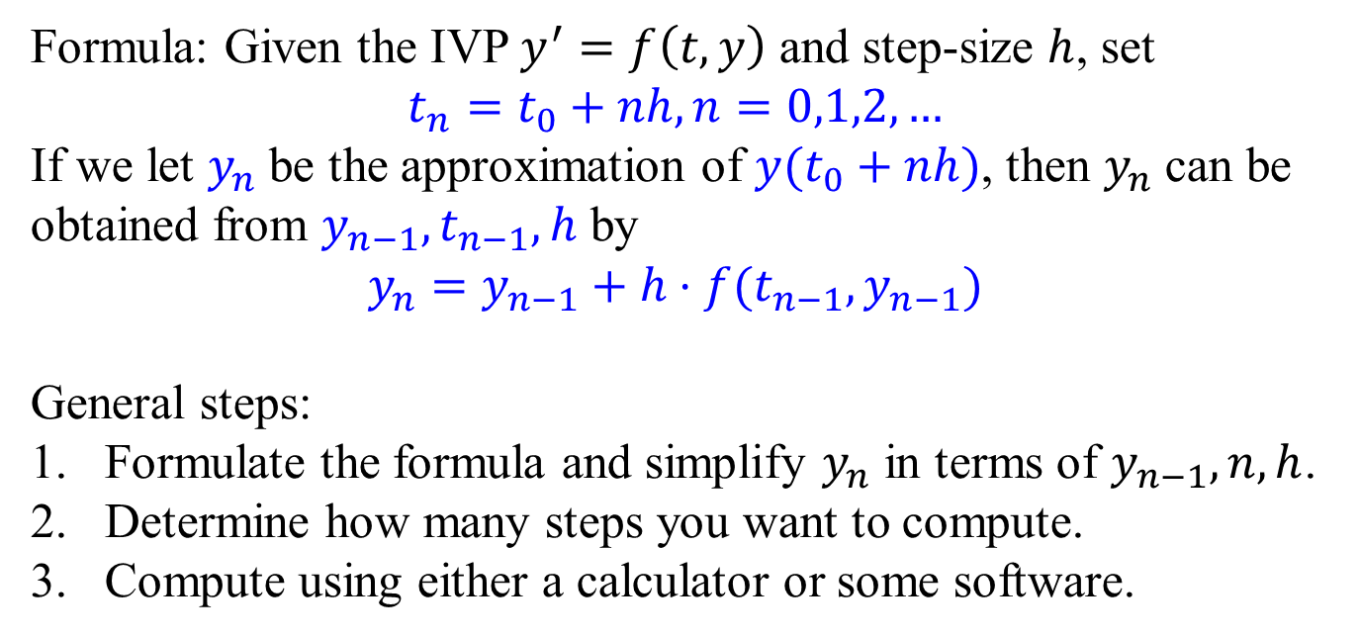
Euler’s method – General Steps
Formula: Given the IVP $y^{′}=f\left(t,y\right)$ and step-size $h$, set
$$t_{n}=t_{0}+nh,n=0,1,2,…$$
If we let $y_{n}$ be the approximation of $y(t_{0}+nh)$, then $y_{n}$ can be obtained from $y_{n−1}, t_{n−1}, h$ by
$$y_{n}=y_{n−1}+h⋅f(t_{n−1},y_{n−1})$$
General steps:
Formulate the formula and simplify $y_{n}$ in terms of $y_{n−1},n,h$.
Determine how many steps you want to compute.
Compute using either a calculator or some software.

Slide 14
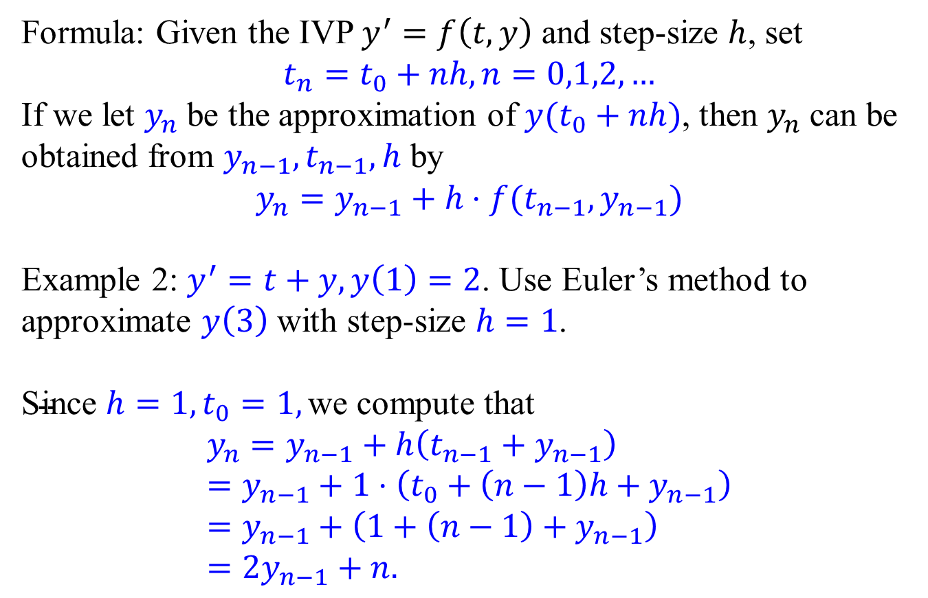
Euler’s method – Example 2
Formula: Given the IVP $y^{′}=f\left(t,y\right)$ and step-size $h$, set
$$t_{n}=t_{0}+nh,n=0,1,2,…$$
If we let $y_{n}$ be the approximation of $y(t_{0}+nh)$, then $y_{n}$ can be obtained from $y_{n−1}, t_{n−1}, h$ by
$$y_{n}=y_{n−1}+h⋅f(t_{n−1},y_{n−1})$$
Example 2: $y^{′}=t+y,y\left(1\right)=2$. Use Euler’s method to approximate $y\left(3\right)$ with step-size $h=1$.
$\text{Since} h=1, t_{0}=1, \text{we} \text{compute} \text{that}$ $$y_{n}=y_{n−1}+h\left(t_{n−1}+y_{n−1}\right)=y_{n−1}+1⋅\left(t_{0}+\left(n−1\right)h+y_{n−1}\right) \\ =y_{n−1}+\left(1+\left(n−1\right)+y_{n−1}\right) \\ =2y_{n−1}+n.$$

Slide 15
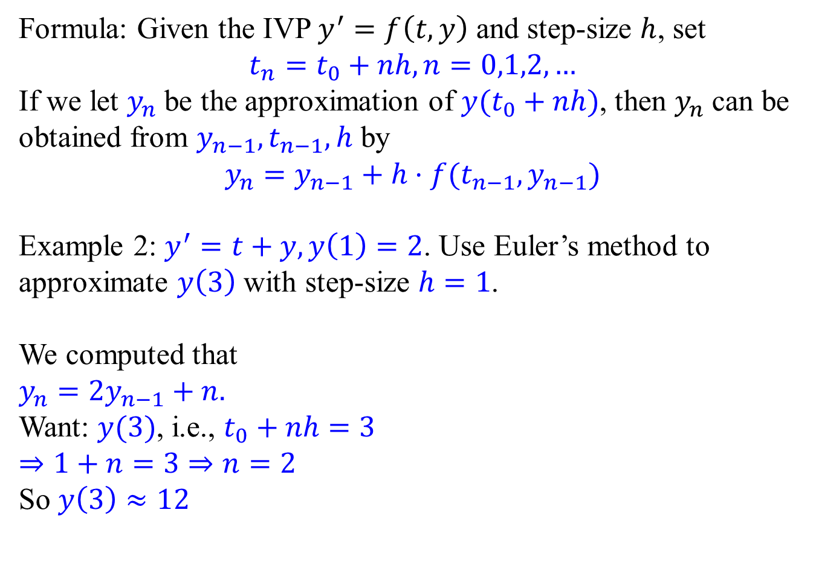
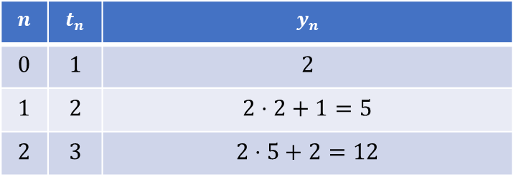
Euler’s method – Example 2
Formula: Given the IVP $y^{′}=f\left(t,y\right)$ and step-size $h$, set
$$t_{n}=t_{0}+nh,n=0,1,2,…$$
If we let $y_{n}$ be the approximation of $y(t_{0}+nh)$, then $y_{n}$ can be obtained from $y_{n−1}, t_{n−1}, h$ by
$$y_{n}=y_{n−1}+h⋅f(t_{n−1},y_{n−1})$$
Example 2: $y^{′}=t+y,y\left(1\right)=2$. Use Euler’s method to approximate $y\left(3\right)$ with step-size $h=1$.
We computed that $y_{n}=2y_{n−1}+n.$
Want: $y(3)$, i.e., $t_{0}+nh=3$
$⇒1+n=3⇒n=2$
So $y\left(3\right)≈12$
$$n$$ | $$t_{n}$$ | $$y_{n}$$
$$0$$ | $$1$$ | $$2$$
$$1$$ | $$2$$ | $$2⋅2+1=5$$
$$2$$ | $$3$$ | $$2⋅5+2=12$$

Slide 16
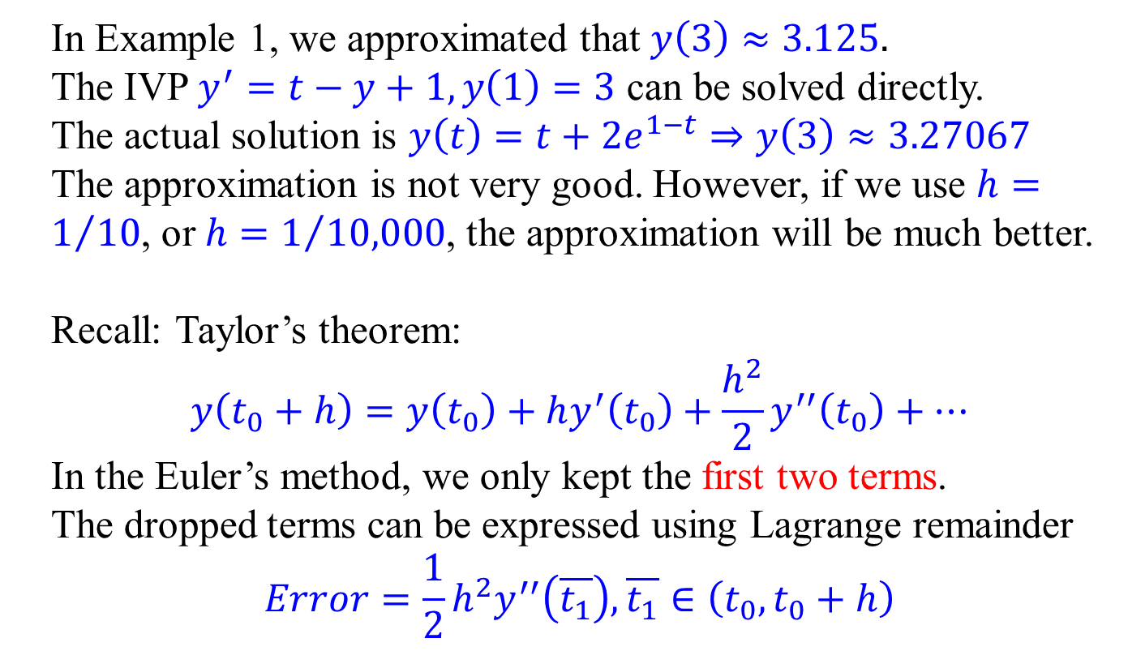
Error analysis
In Example 1, we approximated that $y\left(3\right)≈3.125.$
The IVP $y^{′}=t−y+1,y\left(1\right)=3$ can be solved directly.
The actual solution is $y\left(t\right)=t+2e^{1−t}⇒y\left(3\right)≈3.27067$
The approximation is not very good. However, if we use $h=1/{10}$, or $h=1/{10,000}$, the approximation will be much better.
Recall: Taylor’s theorem:
$$y\left(t_{0}+h\right)=y\left(t_{0}\right)+hy^{′}\left(t_{0}\right)+\frac{h^{2}}{2}y^{′′}\left(t_{0}\right)+⋯$$
In the Euler’s method, we only kept the first two terms.
The dropped terms can be expressed using Lagrange remainder
$$Error=\frac{1}{2}h^{2}y^{′′}\left(\overline{t_{1}}\right),\overline{t_{1}}∈\left(t_{0},t_{0}+h\right)$$

Slide 17
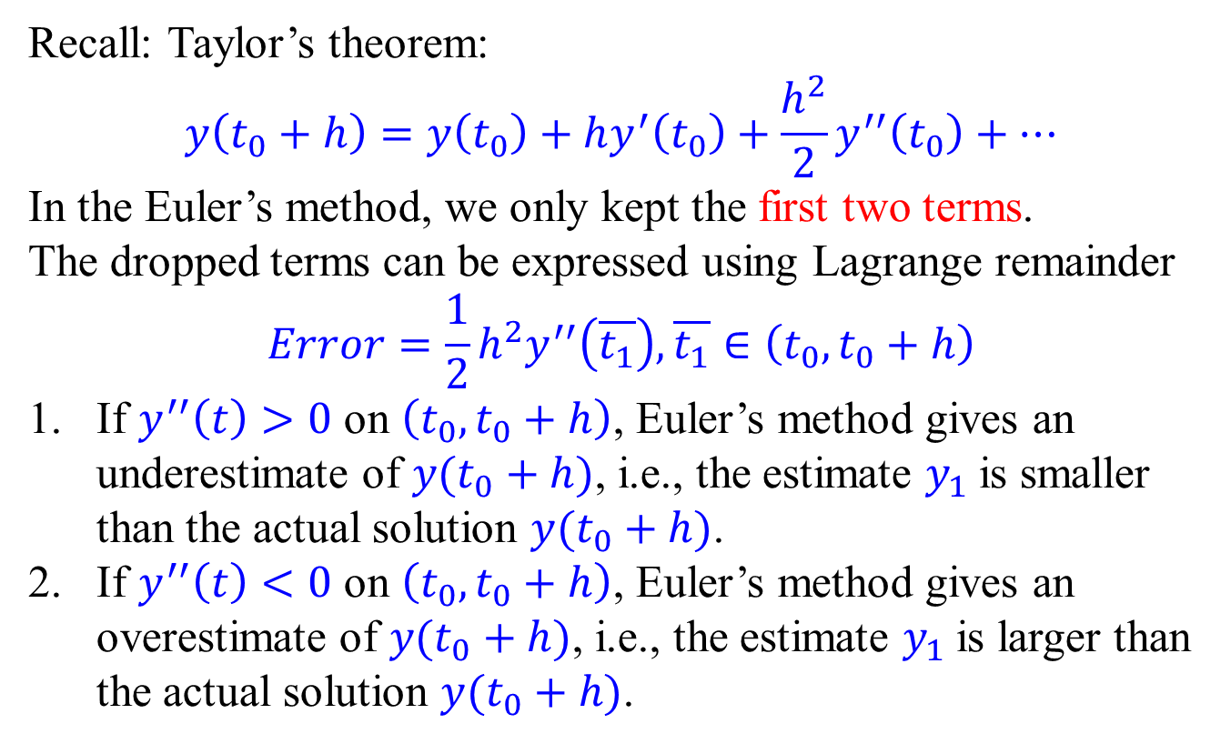
Error analysis
Recall: Taylor’s theorem:
$$y\left(t_{0}+h\right)=y\left(t_{0}\right)+hy^{′}\left(t_{0}\right)+\frac{h^{2}}{2}y^{′′}\left(t_{0}\right)+⋯$$
In the Euler’s method, we only kept the first two terms.
The dropped terms can be expressed using Lagrange remainder
$$Error=\frac{1}{2}h^{2}y^{′′}\left(\overline{t_{1}}\right),\overline{t_{1}}∈\left(t_{0},t_{0}+h\right)$$
If $y^{′′}\left(t\right)>0$ on $\left(t_{0},t_{0}+h\right)$, Euler’s method gives an underestimate of $y(t_{0}+h)$, i.e., the estimate $y_{1}$ is smaller than the actual solution $y(t_{0}+h)$.
If $y^{′′}\left(t\right)<0$ on $\left(t_{0},t_{0}+h\right)$, Euler’s method gives an overestimate of $y(t_{0}+h)$, i.e., the estimate $y_{1}$ is larger than the actual solution $y(t_{0}+h)$.

Slide 18
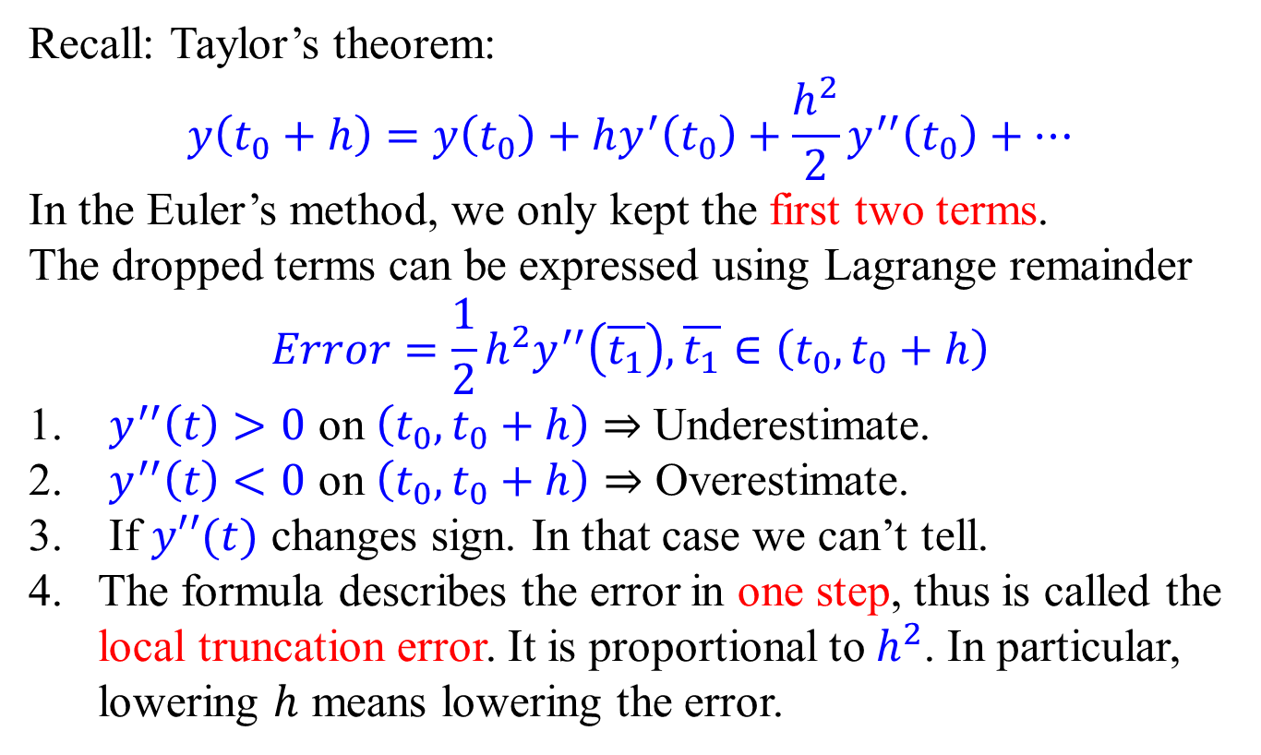
Error analysis
Recall: Taylor’s theorem:
$$y\left(t_{0}+h\right)=y\left(t_{0}\right)+hy^{′}\left(t_{0}\right)+\frac{h^{2}}{2}y^{′′}\left(t_{0}\right)+⋯$$
In the Euler’s method, we only kept the first two terms.
The dropped terms can be expressed using Lagrange remainder
$$Error=\frac{1}{2}h^{2}y^{′′}\left(\overline{t_{1}}\right),\overline{t_{1}}∈\left(t_{0},t_{0}+h\right)$$
$y^{′′}\left(t\right)>0$ on $\left(t_{0},t_{0}+h\right)$ $⇒$ Underestimate.
$y^{′′}\left(t\right)<0$ on $\left(t_{0},t_{0}+h\right)⇒$ Overestimate.
If $y′′(t)$ changes sign. In that case we can’t tell.
The formula describes the error in one step, thus is called the local truncation error. It is proportional to $h^{2}$. In particular, lowering $h$ means lowering the error.

Slide 19
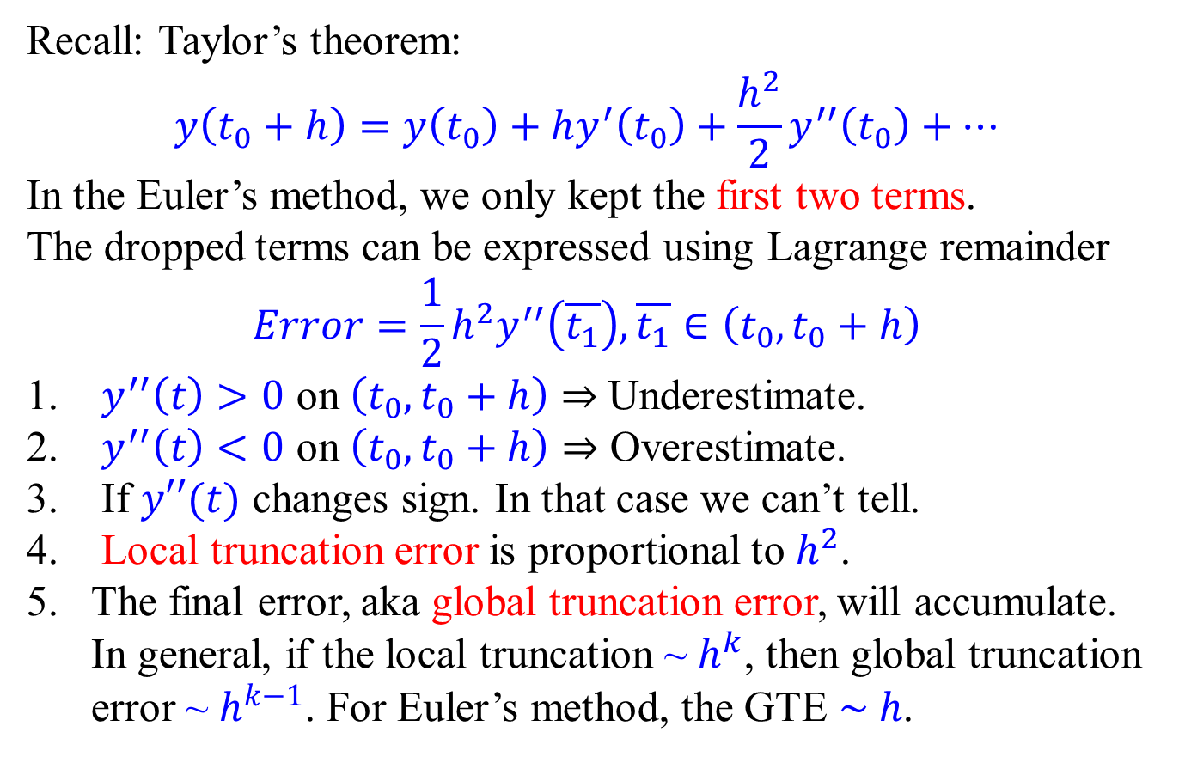
Error analysis
Recall: Taylor’s theorem:
$$y\left(t_{0}+h\right)=y\left(t_{0}\right)+hy^{′}\left(t_{0}\right)+\frac{h^{2}}{2}y^{′′}\left(t_{0}\right)+⋯$$
In the Euler’s method, we only kept the first two terms.
The dropped terms can be expressed using Lagrange remainder
$$Error=\frac{1}{2}h^{2}y^{′′}\left(\overline{t_{1}}\right),\overline{t_{1}}∈\left(t_{0},t_{0}+h\right)$$
$y^{′′}\left(t\right)>0$ on $\left(t_{0},t_{0}+h\right)$ $⇒$ Underestimate.
$y^{′′}\left(t\right)<0$ on $\left(t_{0},t_{0}+h\right)⇒$ Overestimate.
If $y′′(t)$ changes sign. In that case we can’t tell.
Local truncation error is proportional to $h^{2}$.
The final error, aka global truncation error, will accumulate. In general, if the local truncation ~ $h^{k}$, then global truncation error ~ $h^{k−1}$. For Euler’s method, the GTE $\sim h$.

Slide 20
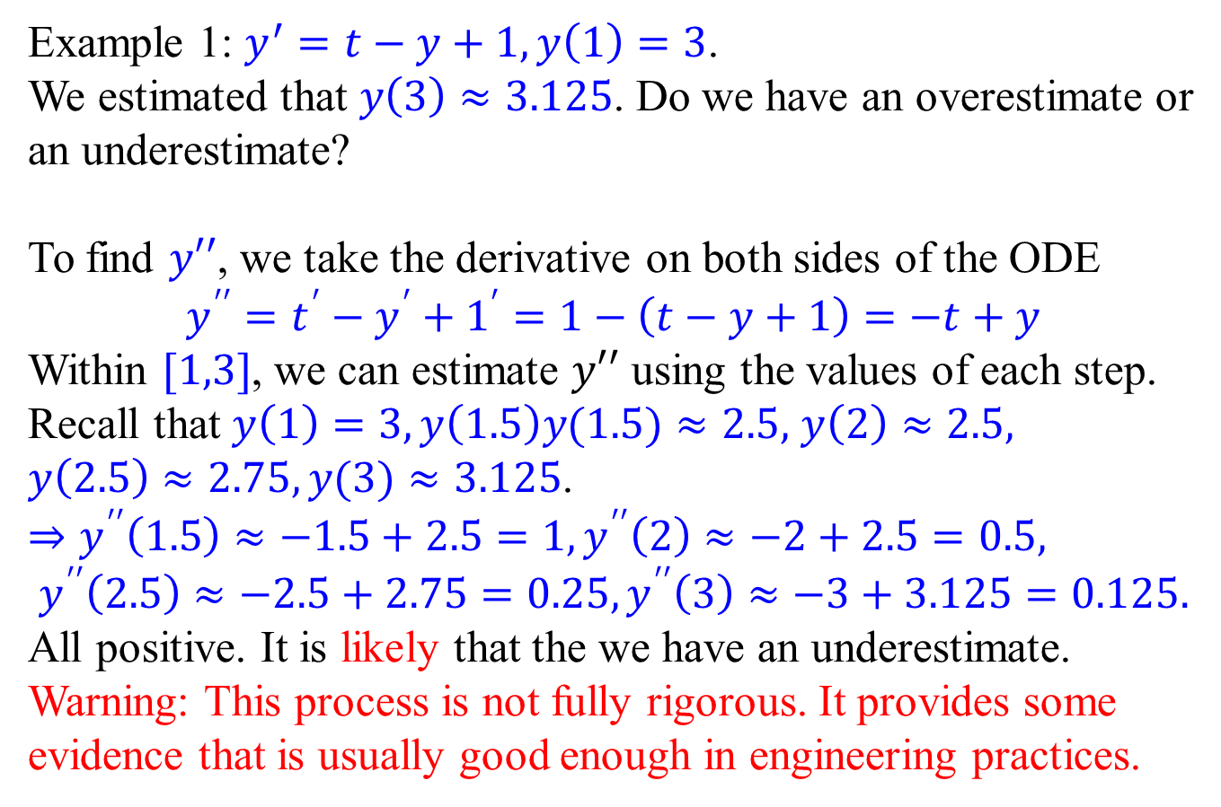
Error analysis – Example 1
Example 1: $y^{′}=t−y+1,y\left(1\right)=3$.
We estimated that $y\left(3\right)≈3.125$. Do we have an overestimate or an underestimate?
To find $y′′$, we take the derivative on both sides of the ODE
$$y^{′′}=t^{′}−y^{′}+1^{′}=1−\left(t−y+1\right)=−t+y$$
Within $[1,3]$, we can estimate $y′′$ using the values of each step.
Recall that $y\left(1\right)=3,y\left(1.5\right)y(1.5)≈2.5,$ $y\left(2\right)≈2.5,$
$y\left(2.5\right)≈2.75,y(3)≈3.125$.
$⇒y^{′′}\left(1.5\right)≈−1.5+2.5=1, y^{′′}\left(2\right)≈−2+2.5=0.5,$ $$y^{′′}\left(2.5\right)≈−2.5+2.75=0.25,y^{′′}\left(3\right)≈−3+3.125=0.125.$$
All positive. It is likely that the we have an underestimate.
Warning: This process is not fully rigorous. It provides some evidence that is usually good enough in engineering practices.

Slide 21
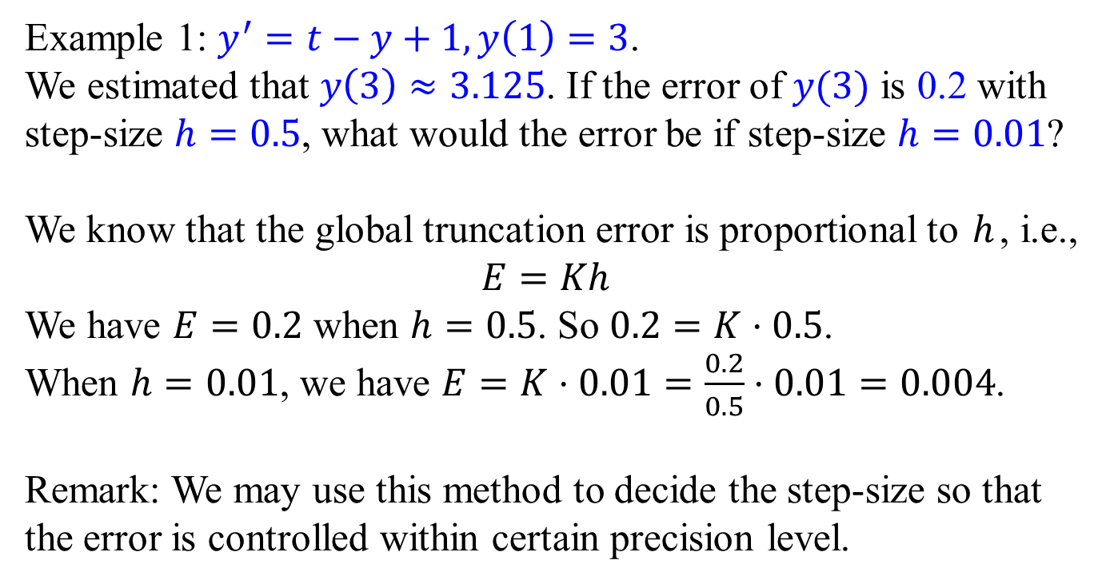
Error analysis – Example 1
Example 1: $y^{′}=t−y+1,y\left(1\right)=3$.
We estimated that $y\left(3\right)≈3.125$. If the error of $y(3)$ is 0.2 with step-size $h=0.5$, what would the error be if step-size $h=0.01$?
We know that the global truncation error is proportional to $h$, i.e.,
$$E=Kh$$
We have $E=0.2$ when $h=0.5$. So $0.2=K⋅0.5$.
When $h=0.01$, we have $E=K⋅0.01=\frac{0.2}{0.5}⋅0.01=0.004$.
Remark: We may use this method to decide the step-size so that the error is controlled within certain precision level.

Slide 22
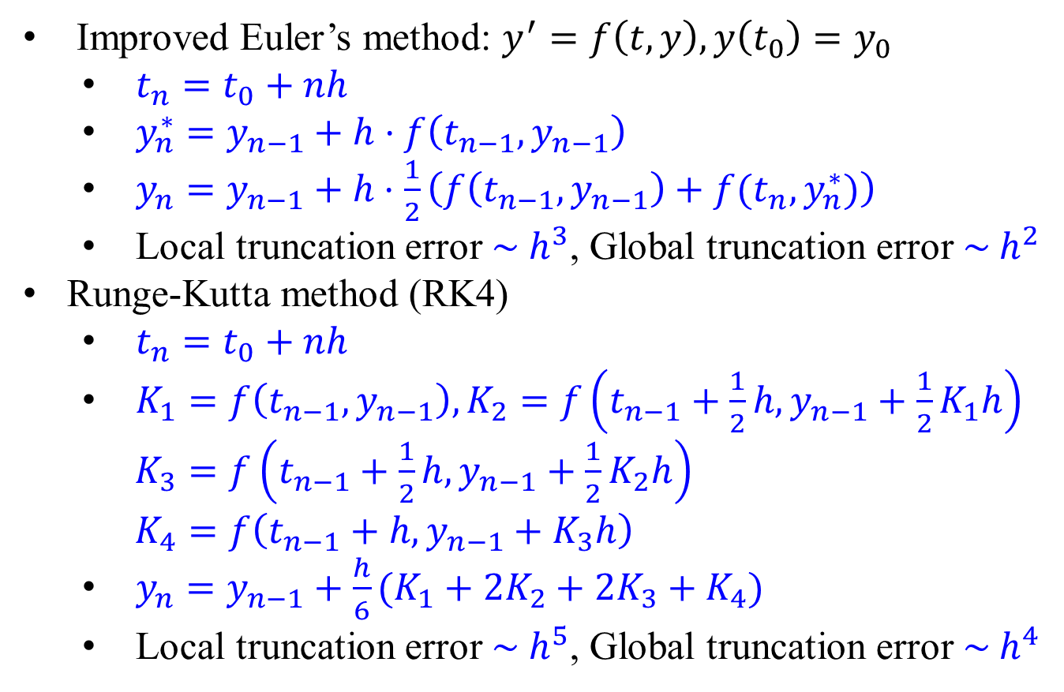
Other numerical methods
Improved Euler’s method: $y^{′}=f\left(t,y\right),y\left(t_{0}\right)=y_{0}$
$t_{n}=t_{0}+nh$
$y_{n}^{∗}=y_{n−1}+h⋅f\left(t_{n−1},y_{n−1}\right)$
$y_{n}=y_{n−1}+h⋅\frac{1}{2}\left(f\left(t_{n−1},y_{n−1}\right)+f(t_{n},y_{n}^{∗})\right)$
Local truncation error ~ $h^{3}$, Global truncation error ~ $h^{2}$
Runge-Kutta method (RK4)
$t_{n}=t_{0}+nh$
$K_{1}=f\left(t_{n−1},y_{n−1}\right), K_{2}=f\left(t_{n−1}+\frac{1}{2}h,y_{n−1}+\frac{1}{2}K_{1}h\right)$ $K_{3}=f\left(t_{n−1}+\frac{1}{2}h,y_{n−1}+\frac{1}{2}K_{2}h\right)$ $K_{4}=f\left(t_{n−1}+h,y_{n−1}+K_{3}h\right)$
$y_{n}=y_{n−1}+\frac{h}{6}(K_{1}+2K_{2}+2K_{3}+K_{4})$
Local truncation error ~ $h^{5}$, Global truncation error ~ $h^{4}$

